Slide 1
A Crash Course on LaTeX
Discussion Section – April 24

Slide 2
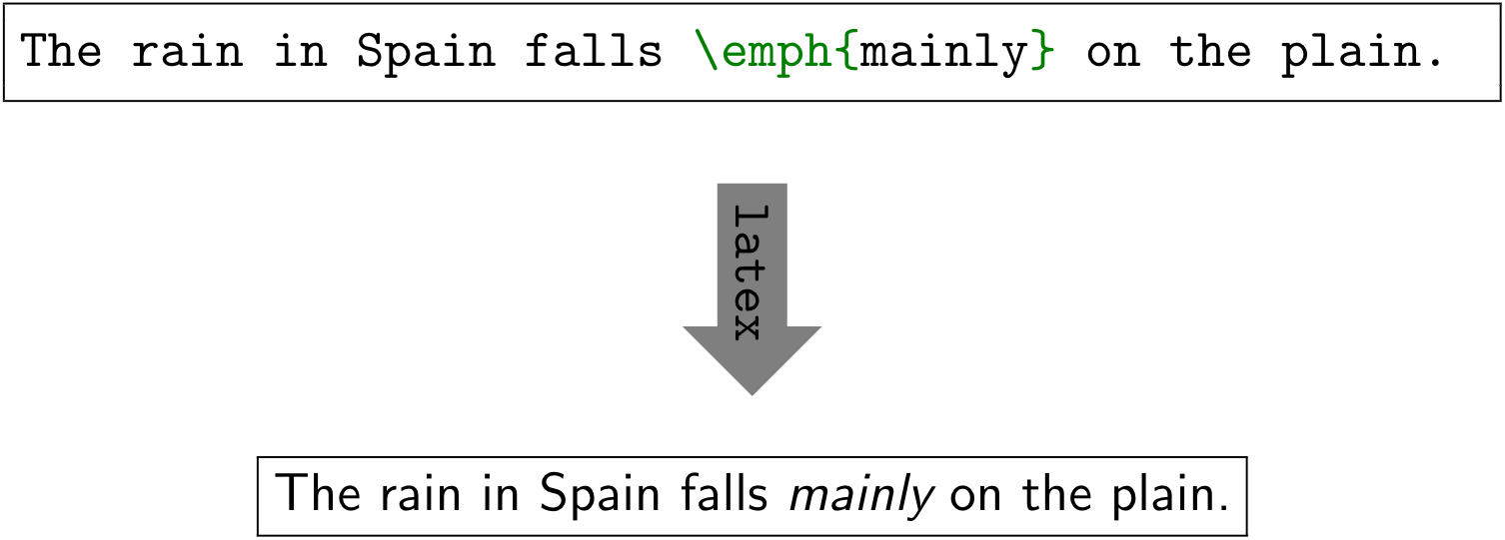
Why LaTeX?
LaTeX is a typesetting systems suitable for producing scientific and mathematical documents
LaTeX enables authors to typeset and print their work at the highest typographical quality
LaTeX is pronounced “Lay-tech”.
LaTeX uses TeX formatter as its typesetting engine.

Slide 3
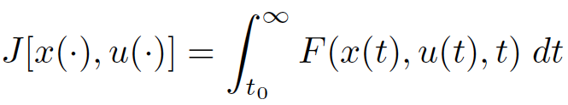
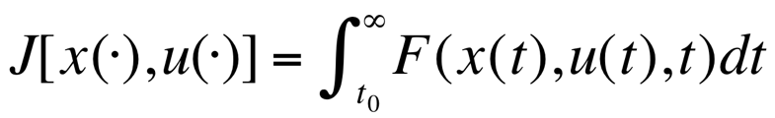
Why LaTeX?
Word
High quality
Easy to use, especially for typing mathematical formulas
Portability (Windows, Unix, Mac)
But most likely, you will be forced to use it, since everyone else around you is using it.
LaTeX

Slide 4
Setting up LaTeX
LaTeX package
Download and install MikTeX
http://www.miktex.org/
Install Ghostscript and Gsview
http://pages.cs.wisc.edu/~ghost
Install Acrobat Reader
Install Editor
WinEdt
Or use online LaTeX editors: Overleaf, Sharelatex..
PS device driver
For MAC Users
TeXShop
iTexMac
Texmaker
…

Slide 5
Basic Structure
\documentclass [12pt]{article}
\usepackage {color}
\usepackage {graphicx}
\begin{document}
\end{document}
Define the types of the document (article, book, thesis …)
Preamble. Incorporate packages or define macros here
Main body, stuff to be printed, title, authors, abstract, sections, references, ….

Slide 6
Basic Document Structure
\begin{document}
\title {A Very Simple Introduction to LaTeX}
\author {names}
\thanks{names}
…
\maketitle
…
\section{Introduction}
\subsection{Subsection Heading Here}
\end{document}

Slide 7


Environments
\begin{env_name}
stuff
\end{enc_name}
Environment name (env_name) can be
document, itemize, enumerate, tabular, etc.
\begin{itemize}
\item The first item
\item The second item
\end{itemize}
\begin{enumerate}
\item The first item
\item The second item
\end{enumerate}

Slide 8
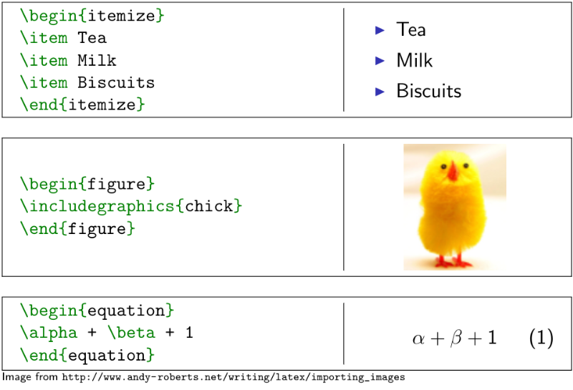
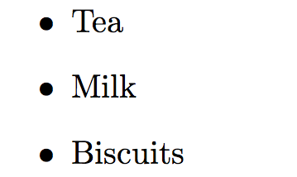
More examples..

Slide 9
Figures
You can insert figures in pdf, jpg, eps, and other formats into your document.
\begin{figure}
\centering
\includegraphics {name of the figure file}
\caption{Put the caption here}
\end{figure}
Multiple figures can be inserted using \subfigure

Slide 10
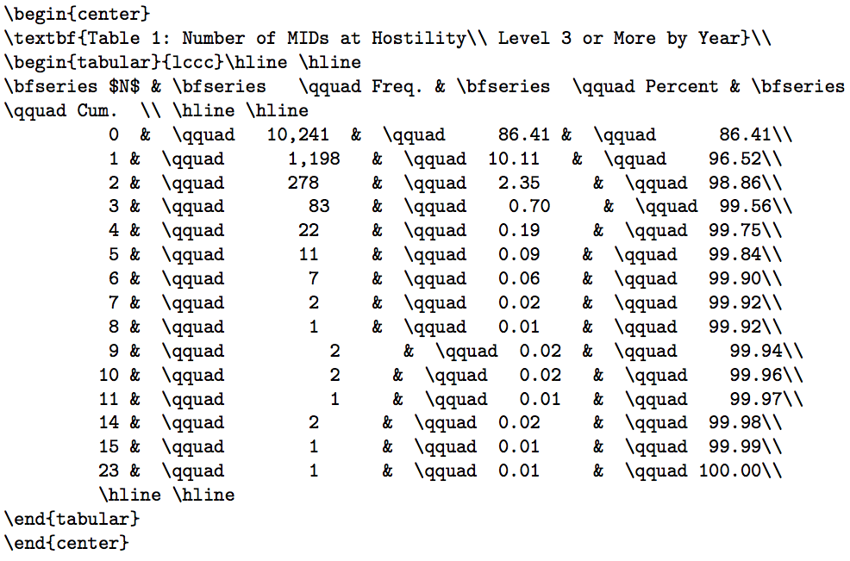
Tables
An example to show how to generate tables

Slide 11
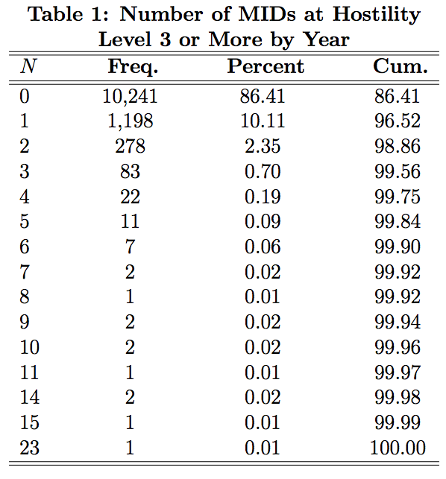
Output

Slide 12
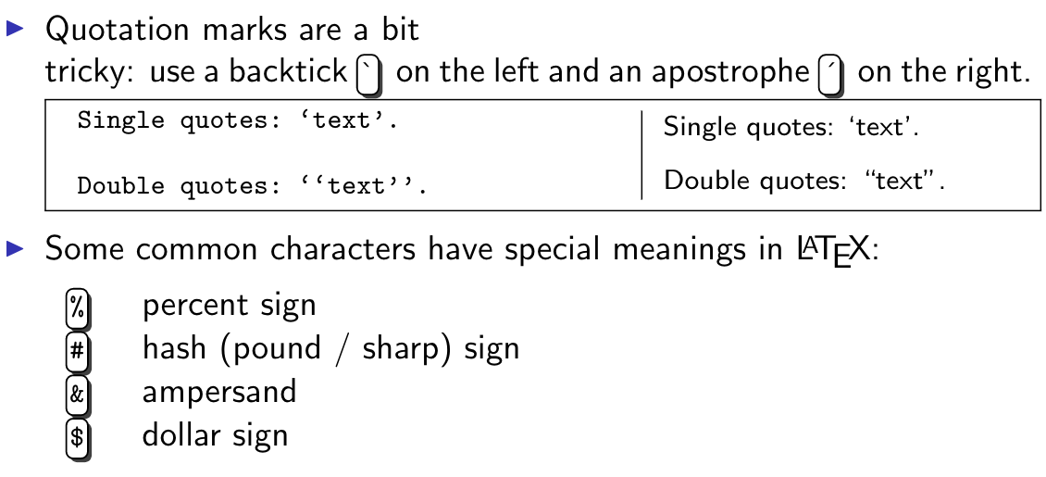
Special Characters

Slide 13
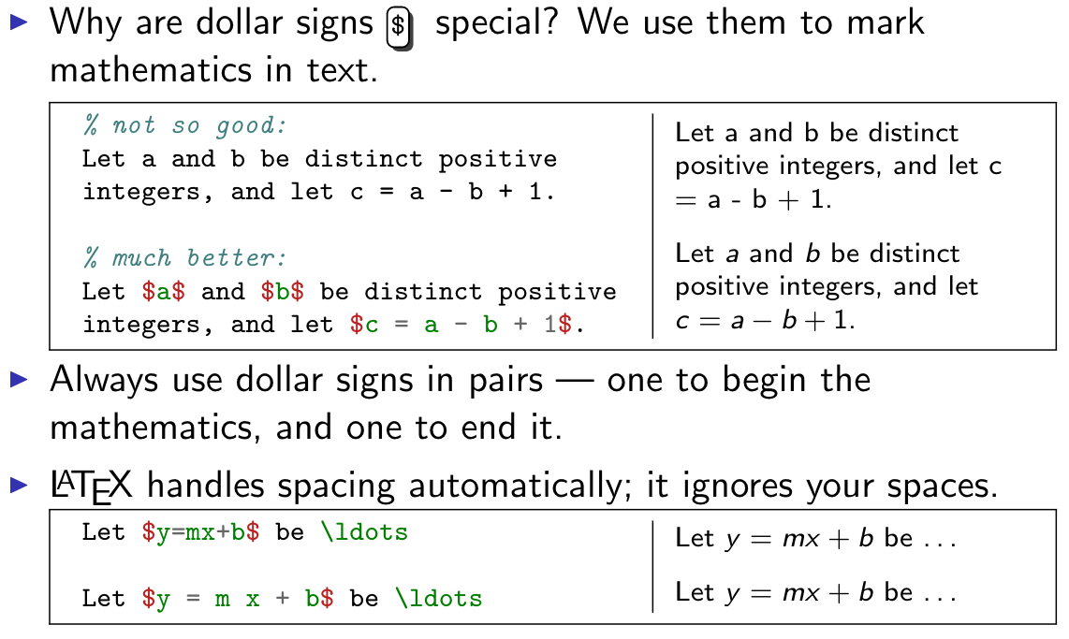
Typesetting Mathematics: Dollar Sign

Slide 14
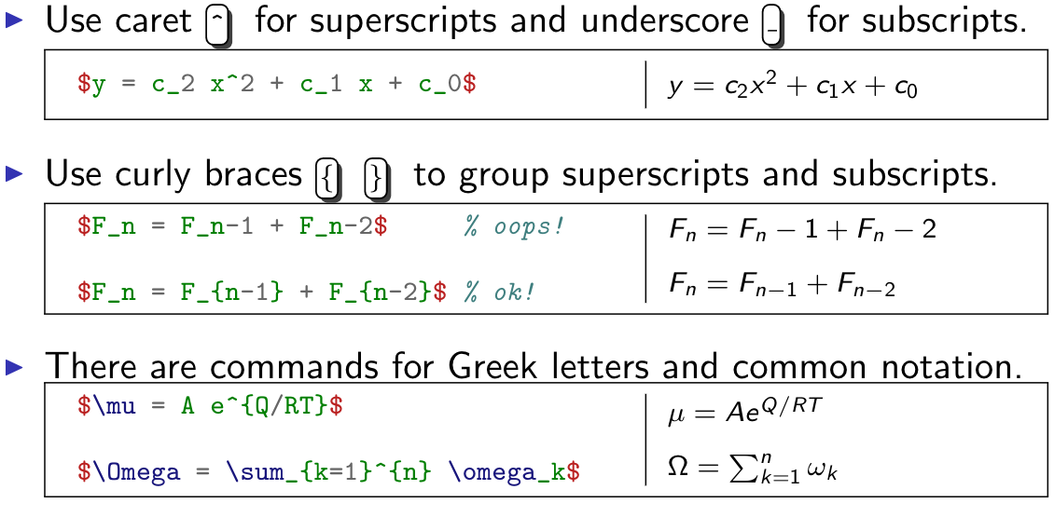
Typesetting Mathematics: Notation

Slide 15
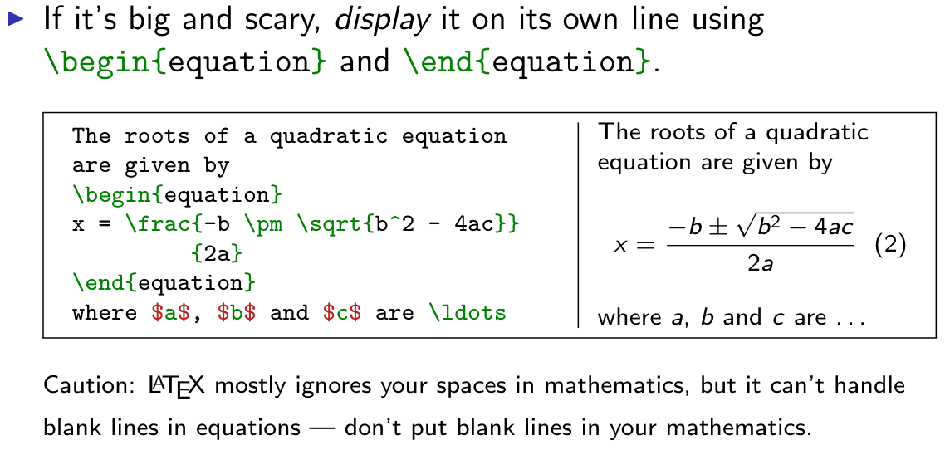
Typesetting Mathematics: Equations

Slide 16
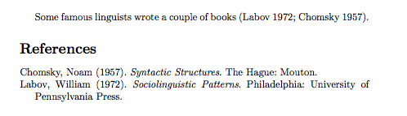
How to cite references?
Using .bib file, we create a list of references
After importing, we cite them in our main document using the command \cite
Formatting:
I. Author1 and J. Author2. “The title of the paper.” Name of Journal, vol(#), month year OR
I. Author1, J. Author2 and K. Author3. “The title of the paper.” Proceedings of the Name of the Conference, location, month year.
Suppose we have to generate something like this..

Slide 17
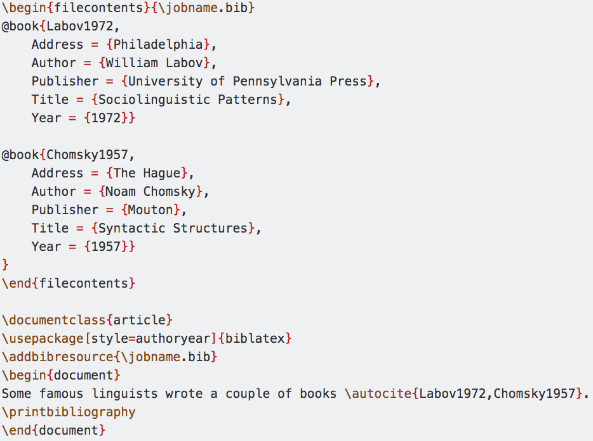
Author/Year Style
This is in the .bib file
This is in the main.tex document
Image from tex.stackexchange.com

Slide 18
Thank you!
Some of the content in the slides are taken from Overleaf tutorial, Stackexchange and cs.helsinki.fi

